Slide 1


Economics 112 Syllabus Shabnam Shahrezaei
Instructor and Availabilities
Textbook and Reading References
Problem Sets, Assessments, Grading
Technology and Communication Platforms
Class Expectations and Etiquette Rules
Important Dates and Deadlines
Weekly Topical Coverage, Objectives, Tasks
Important Policies
Bi-Weekly Self-Assessment Report
Source of Image: OpenAI. AI-generated image of the U.S. economic boom (1945–1973). ChatGPT, 2025

Slide 2

1. Instructor and Availabilities
Instructor
Shabnam Shahrezaei: PhD candidate, Economics Department, Emory University
Class Time: TTH 11:30am – 1:00pm
Classroom: Online on Zoom: Link , Meeting ID: 979 3974 3702 , No Passcode
Office Hours: Mondays 11:00am – 12:00pm on Zoom: Meeting ID: 3368637695, No Passcode
E-mail: shabnam.shahrezaei@emory.edu
Prerequisite: ECON 101 or ECON OX 101 or FIN 201
Credit Hours: 3

Slide 3


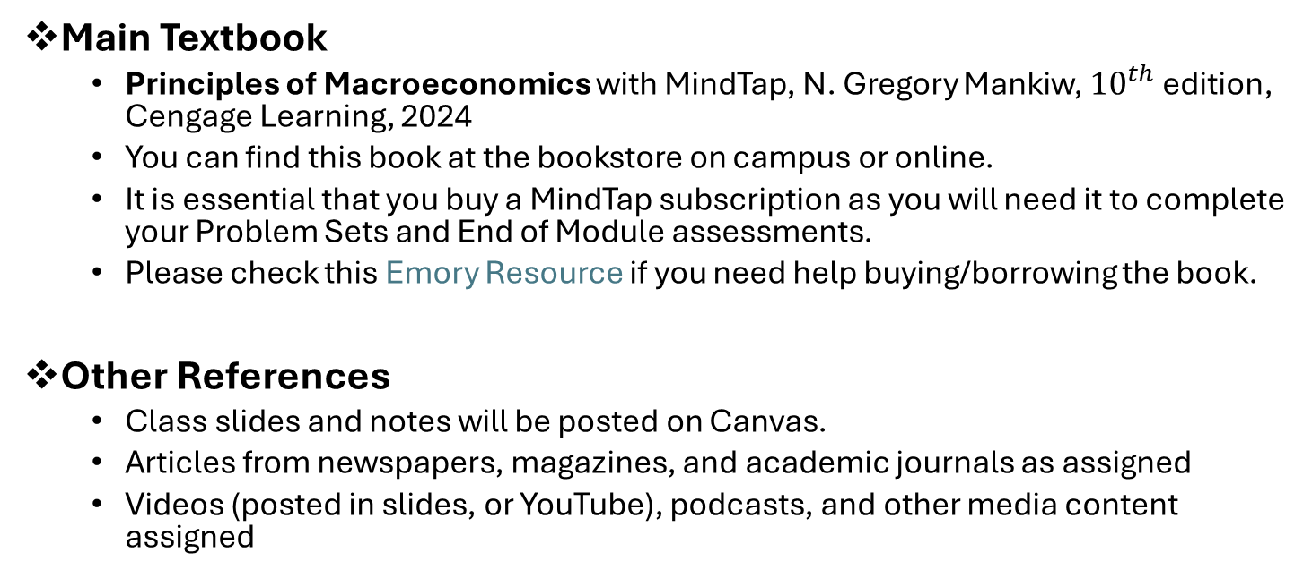
2. Textbook and Reading References
Main Textbook
Principles of Macroeconomics with MindTap, N. Gregory Mankiw, ${10}^{th}$ edition, Cengage Learning, 2024
You can find this book at the bookstore on campus or online.
It is essential that you buy a MindTap subscription as you will need it to complete your Problem Sets and End of Module assessments.
Please check this Emory Resource if you need help buying/borrowing the book.
Other References
Class slides and notes will be posted on Canvas.
Articles from newspapers, magazines, and academic journals as assigned
Videos (posted in slides, or YouTube), podcasts, and other media content assigned

Slide 4
3. Assignments, Exams, Grading
Quizzes (50%): There will be 5 weekly quizzes
Problem Sets (40%): There will be 5 weekly problem sets
Engagement (10%): I will count canvas-based engagement activities as well as class attendance and contribution
Bonus Points:
Pop-up Questions: Randomly throughout the class, I will ask pop-up questions. Students who provide the correct answer will earn bonus points, which will be added to their final grade.
Self Assessment Sheet: A detailed explanation can be found on the last two pages of this syllabus.
Note: Failure to take a Quiz or turn in an assignment will lead to a score of zero for that activity. No exceptions!

Slide 5
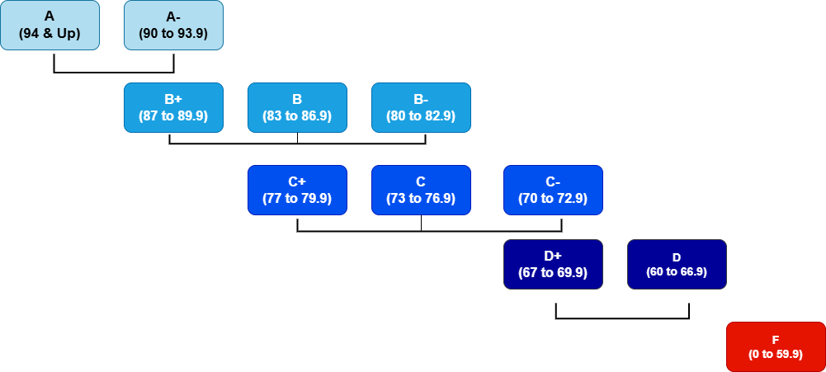
Grading Scale
Please note that I do not adjust final grades up and down no matter how close you are to the next grade.

Slide 6
Support Sources
Support for Students with Special Needs
Students with special needs for reasonable accommodations must register with the Department of Accessibility Services at https://accessibility.emory.edu/students/index.html . It is students’ responsibility to request accommodations. For more info contact accessibility@emory.edu or call (404) 727-9877.
Note: Accommodations are not retroactive, so contact me very early in the semester to discuss your accommodations plan.

Slide 7


4. Technology and Communication Platforms
Canvas is a communication medium used to make announcements, distribute handouts and lectures, post reading material, collect assignments, and record & distribute grades. To get to the Canvas main page go to https://classes.emory.edu and use your e-mail ID and Password to log in to select our course. For login issues contact classes@emory.edu . There are several navigation buttons on our entry page to help us organize and classify information. We will have a tour of our Canvas system on the first day of class.
Zoom is an enterprise video communication system we may use for review and help sessions or in the case of emergency, You must register as an Emory user with Zoom to be able to access our Zoom sessions. To download and get to Zoom page go to https://emory.zoom.us/. Watch Zoom Basics for Students. For help call Emory help (404) 727-7777 or go to https://support.zoom.us/hc/en-us.
Zoom addresses for class and office hours will be provided on this syllabus's “Instructor and Availabilities” page.

Slide 8
5. Class Expectations and Etiquette Rules
Before Class
Complete the reading (Textbook) and any viewing assignments
View the posted PowerPoint Lecture Slides for the coming lecture
During Class
Join the class on Zoom with your video on, dressed appropriately, and in a suitable learning environment
Be punctual, prepared, attentive, engaged, and comply with the etiquette rules
Be ready to answer pop-up questions
After Class
Complete any reading or viewing assignments
Do the homework problems corresponding to today’s lecture
Watch any video assigned on Canvas
Expectations

Slide 9
5. Class Expectations and Etiquette Rules
Make sure not to miss any class, there is no make up for any quizzes conducted in class
Please join the Zoom session on time, as late entry will not be allowed after the first five minutes.
Texting or other forms of communication are not allowed during the class
Ensure your device and internet connection are stable before joining the class.
Honor Code Violations
Will be dealt with decisively (failing grade and expulsion from the School).
For more information see: http://catalog.college.emory.edu/policies/honor-code.html
Using AI without acknowledgement is a Violation.
Etiquette Rules

Slide 10
6. Important Dates and Deadlines
Problem Sets
Problem set 1 due: Sunday, July 6th, 6:00 p.m.
Problem set 2 due: Sunday, July 13th, 6:00 p.m.
Problem set 3 due: Sunday, July 20th, 6:00 p.m.
Problem set 4 due: Sunday, July 27th, 6:00 p.m.
Problem set 5 due: Sunday, August 3rd, 6:00 p.m.
End of Module Assessments
Quiz 1 due: Tuesday, July 8th, during class
Quiz 2 due: Tuesday, July 15th, during class
Quiz 3 due: Tuesday, July 22nd, during class
Quiz 4 due: Tuesday, July 29th, during class
Quiz 5 due: Tuesday, August 5th, during class
Bonus Point
Self Assessment Sheet due: Tuesday, August 5th, 6:00 p.m.

Slide 11
7. Weekly Topical Coverage, Objectives, Tasks
Course Overview
This course is the second course in the introduction to the economics sequence. The focus is on the whole (macro) economy of a nation. Among the topics covered are:
The factors that determine long-run growth in output
The role of the financial system in investment
The money supply and the Federal Reserve System
Short-run fluctuations in prices, output, and employment
Possible government monetary and fiscal policies to remedy these fluctuations
In the next few slides, various topics covered in this course are listed along with the learning objectives, assignments, reading material, and instructional tasks related to each topic.

Slide 12
I. The Data of Macroeconomics (July 1 and 3)
Learning Objective
Measuring the Nation’s Income
Measuring the Cost of Living
Assigned Material
Mankiw Chapters 10, 11
PowerPoint Slides 112-01, 112-02
Posted Videos on Canvas under Topic I
Tasks
Do Problem Set 1, July 6th
Quiz 1 on Tuesday, July 8th
Topic I

Slide 13
II. The Real Economy in the Long Run (July 8, 10)
Learning Objective
Production and Growth
Savings, Investment, and Finance
Assigned Material
Mankiw Chapters 12, 13
PowerPoint Slides 112-03, 112-04
Posted Videos on Canvas under Topic II
Tasks
Do Problem Set 2, July 13th
Quiz 2 on Tuesday, July 15th
Topic II

Slide 14
II. The Real Economy in the Long Run (July 15, 17)
Learning Objective
The Basic Tools of Finance
Unemployment
Assigned Material
Mankiw Chapters 14, 15
PowerPoint Slides 112-05, 112-06
Posted Videos on Canvas under Topic II
Tasks
Do Problem Set 3, July 20th
Quiz 3 on Tuesday, July 22nd
Topic II

Slide 15
III. Money and Prices in the Long Run (July 22, 24)
Learning Objective
The Monetary System
Money, Growth and Inflation
Assigned Material
Mankiw Chapters 16, 17
PowerPoint Slides 112-07, 112-08
Posted Videos on Canvas under Topic III
Tasks
Do Problem Set 4, July 27th
Quiz 4 on Tuesday, July 29th
Topic III

Slide 16
IV. Short-Run Economic Fluctuations (July 29, 31, and August 5)
Learning Objective
Aggregate Demand and Aggregate Supply
Monetary and Fiscal Policy
Assigned Material
Mankiw Chapters 20, 21
PowerPoint Slides 112-09, 112-10
Posted Videos on Canvas under Topic IV
Tasks
Do Problem Set 5, August 3rd
Quiz 5 on Tuesday, August 5th
Submit Self-Assessment Sheet
Topic IV

Slide 17
8. Important Policies
Quiz Policy
Quizzes are not optional; they are mandatory.
I will drop your lowest quiz score.
No retakes will be provided under any circumstances.
Absence Policy
If you have a compelling reason preventing you from attending a Quiz (e.g., illness, student-athlete commitments, or a personal emergency), you must:
Email me before the Quiz day, explaining your absence.
Submit a self-absence form (under the honor code) confirming your absence on the specified date.
If your absence is excused, the weight of the first missed quiz will be reallocated to your lowest score among the completed ones.
Problem Sets Policy
Problem Sets will be posted on Canvas with the due dates as listed in the syllabus.
Late submissions will incur a 20% grade penalty per day.
Failure to submit a problem set will result in a zero, with no exceptions.
This policy applies without exception—please plan accordingly.

Slide 18
9. Bi-Weekly Self-Assessment Report
Self Assessment Scores:
You are asked to assess the effort you put into each class on scale of 0 to 5, with 5 indicating the most effort. You will record these scores on the last page of this syllabus on a bi-weekly basis. Copy the assessment page, fill it out on a bi-weekly basis, and turn it in on Canvas toward the end of the semester. You get bonus points for turning this score sheet in, irrespective of the scores you report. These scores will be used to study course outcome only after the semester is over and grades are reported. We appreciate your honest assessment of your efforts which makes the scores meaningful.

Slide 19
9. Bi-Weekly Self-Assessment Report
Self-Assessment Scores:
Your Name (Last, First): _________________________
Please assess the effort you put into each class and use the format below to report it on a scale of 0 to 5, with 5 indicating the most effort. Report the scores every two weeks. Detach this page and submit it on Canvas on Tuesday, August 5th, 6:00 p.m.. You get bonus points for turning this score sheet in, irrespective of the scores you report. These scores will be used to study course outcome only after the semester is over and grades are reported. We appreciate your honest assessment of your efforts which makes the scores meaningful.
Please circle the correct score ( 0 means awful and 5 outstanding)
Self Evaluation Score for Topic I→ ………………….. 0 1 2 3 4 5
Self Evaluation Score for Topic II→ ……………….... 0 1 2 3 4 5
Self Evaluation Score for Topic III→ …………….….. 0 1 2 3 4 5
Self Evaluation Score for Topic IV→ ……………….. 0 1 2 3 4 5

